Slide 1
Deploying the Customer Data Base on Cloud Using AWS
Cloud Computing
360DigiTMG Cloud Computing Project

Slide 2
01
Project Time Line
04
What and Why Use AWS RDS with MySQL
E-COMMERCE
02
05
Database Migration Design
INTERNET SHOPPING
Project Objectives
03
What & Why Cloud Computing
AGENDA

Slide 3

Project Time Line
Cloud
Database
Schema Diagram
Final Database
Realtime working and Support setup
To complete the task
by estimated date
how confident are
you
Need to understand the business requirements and decide which database to be used
Show the Schema diagram and entity relationship with all relevant fields
Actual database inside the server including all the tables and the data
Live database ready to support the client
2
03/09/2020
04/09/2020
10/09/2020
14/09/2020
17/09/2020

Slide 4
Project Objectives
Create an efficient solution for storing data and managing it for future requirements, real time analytics and scalability
To design and build a database schema on cloud (AWS)
Identify and propose which type of database to be used on cloud
Provide business justification for the solution identified
The solution must provide provision for advanced AI and ML applications

Slide 5






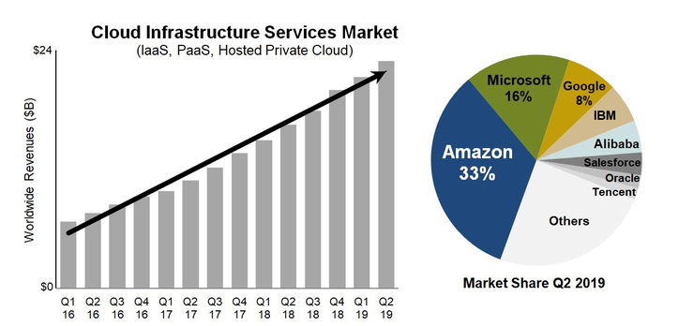
What and Why Use AWS RDS with MySQL

Slide 6
Advantages of RDS :
Faster Query Processing
Portable
Large amount of data is retrieved quickly and efficiently. Operations like Insertion, deletion, manipulation of data is also done in almost no time.
It allows you to easily configure read replicas or set up synchronous replication across availability zones for enhanced performance, availability, and durability.
Easy Coding Skills
Easy Maintenance
For data retrieval, large number of lines of code is not required. All basic keywords such as SELECT, INSERT INTO, UPDATE, etc are used and also the syntactical rules are not complex in SQL, which makes it a user-friendly language.
In Amazon RDS, AWS takes full responsibility for your database. The entire process of configuration, management, maintenance, and security is automated by AWS.

Slide 7
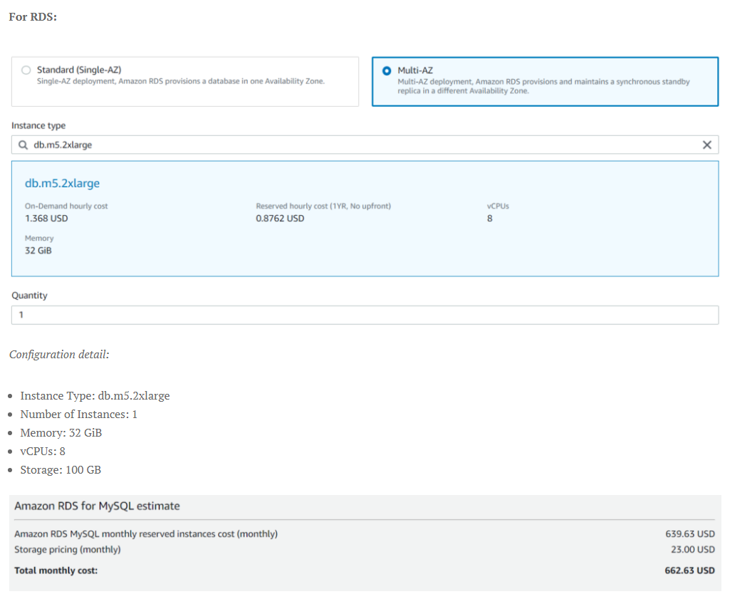
Advantages of RDS and Costing:
RDS has a little edge over EC2. Here’s why:
1. Optimized DB Solutions & Replication: There’s no need to manually set up database mirroring and failover clusters since you already get this in RDS.
2. Outsource tasks: You can outsource tasks like database provisioning, security, and updating versions.
3. Focus on important tasks: It allows you to focus on tasks like schema optimization and performance tuning.
4. Automatic Backups: In case of a disaster, RDS manages your backups automatically.
Take Away: The client can easily expand the storage,
memory, and vCPU easily. In addition the
client can focus on important task and leave
the security, updates, disaster recovery, and backups all to AWS. Making the Environment
Future Proof.

Slide 8
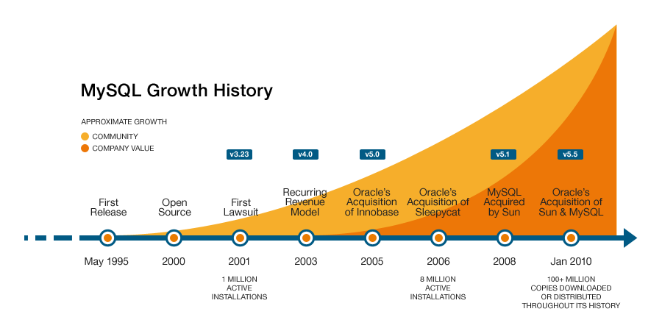

It is widely used in the Business Intelligence tool.
Data Manipulation and data testing are done through SQL.
Data Science tools depend highly on SQL. Big data tools such as Spark, Impala are dependent on SQL.
SQL is been long in the market resulting to have a lot of supports from developers, and community.
Due to documentation and long establishment over years, it provides a uniform platform worldwide to all its users.

Slide 9
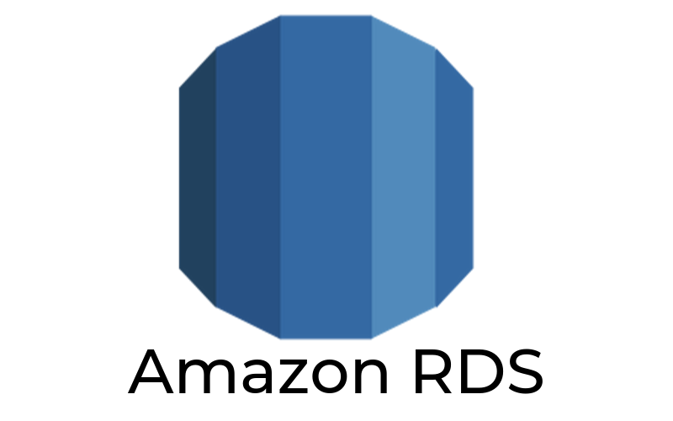


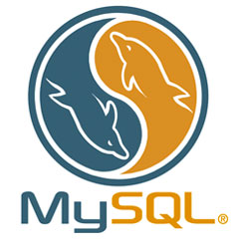
Database Migration Design
AWS
Database located
ON-PREMISE
MySQL RDS Cluster

